Slide 1
Project title implementing an Erp system for mix Prand clothing factory using Odoo 17
Team members
Aya gamal eed elshrakwy
Mona ayad
Essra badr el_din
Mahmoud amr
Alaa rifaat
Instructorname.Diaa hamdan

Slide 2

introduction
Main Objective: To provide a comprehensive solution for managing all operations within the clothing factory, including manufacturing, inventory, sales, and procurement, using Odoo ERP 17.

Slide 3

2. Challenges Faced by the Factory:
Inaccurate Data: Using Excel sheets led to inaccurate accounting and stock quantities.Lack of Information and Reports: No system for generating accurate reports on procurement, sales, and inventory.No Integration Between Departments: Operations were fragmented and not efficiently connected.

Slide 4
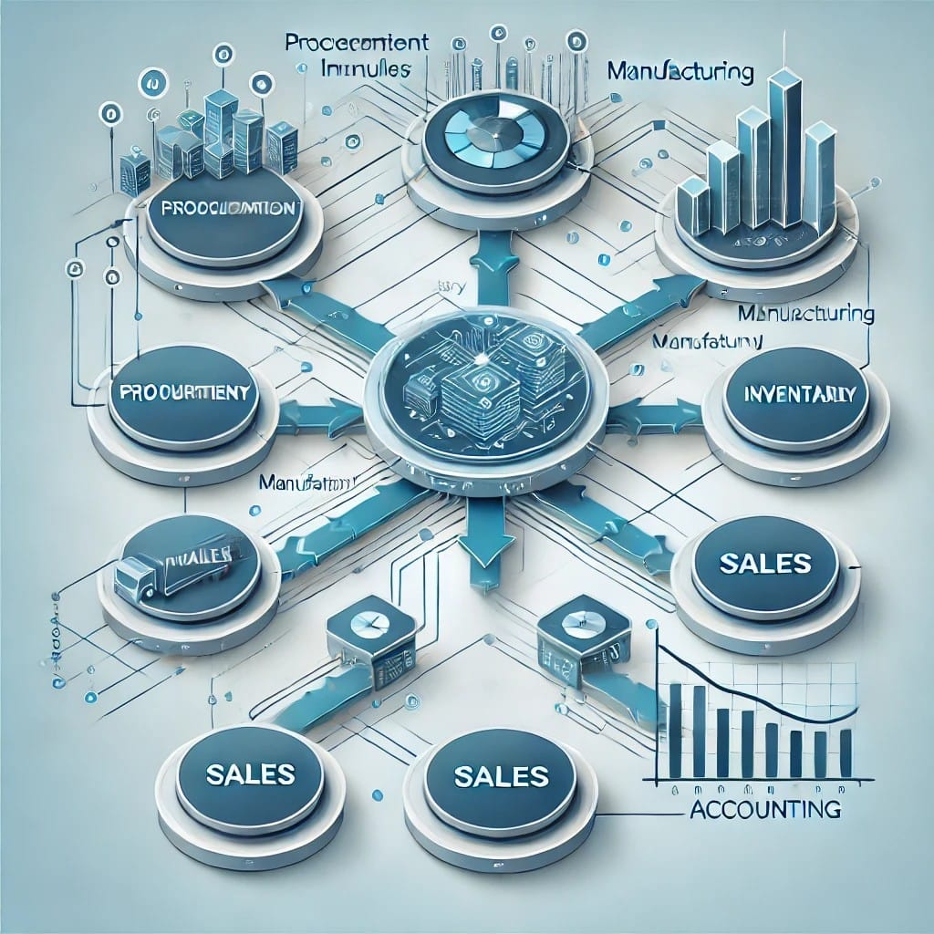
Solution Provided with Odoo ERP:
Modules Used:
Procurement Management
.Inventory Management.
Manufacturing.
Point of Sale.
Accounting.
sales
Process Integration: Linking all processes from procurement through manufacturing to sales, allowing for direct connectivity between departments.Role-based Permissions: Assigning specific permissions to each employee based on their role to enhance security and reduce errors.

Slide 5

Project Results:
Improved Data Accuracy: The stock and sales data became accurate and reliable, aiding better decision-making.
Comprehensive Reporting: The ability to generate detailed reports on sales, inventory, and procurement, increasing operational transparency.
Complete and Efficient Workflow: A full cycle starting from raw material procurement to the distribution of final products.
Reduced Errors: The system helped minimize errors related to accounting and stock managemen

Slide 6
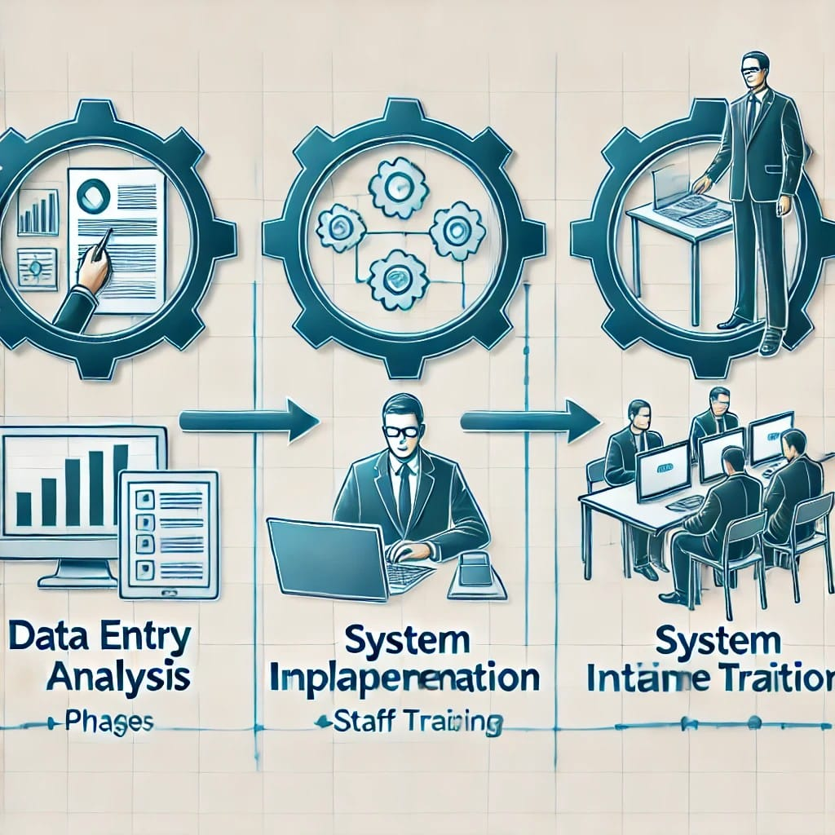
Project Phases:
Phase 1: Data entry and understanding client needs.
Phase 2: System implementation and reviewing the processes with different departments to ensure the solution matches the factory's needs.
Phase 3: Training employees and ensuring the system runs efficiently.

Slide 7

Conclusion
Emphasizing the importance of digital transformation in enhancing the efficiency of factory management.
The role of Odoo in providing flexible, integrated solutions for all aspects of manufacturing, inventory, and sales.

Slide 8

Call to Action:
Encouraging the adoption of advanced ERP solutions to achieve greater success and efficiency in factory management.

Slide 9
